Slide 1
Data interpretation
Concepts, Solved Examples & Preparation Strategies
\

Slide 2
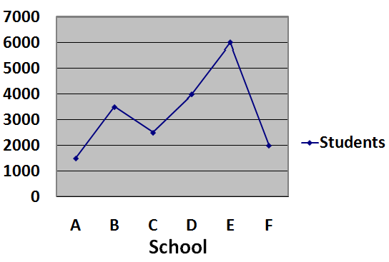
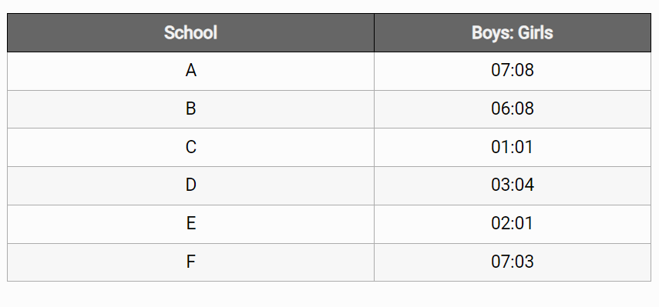
Study the following graph and answer the following questions:-
Total students in Six different schools:-
01

Slide 3
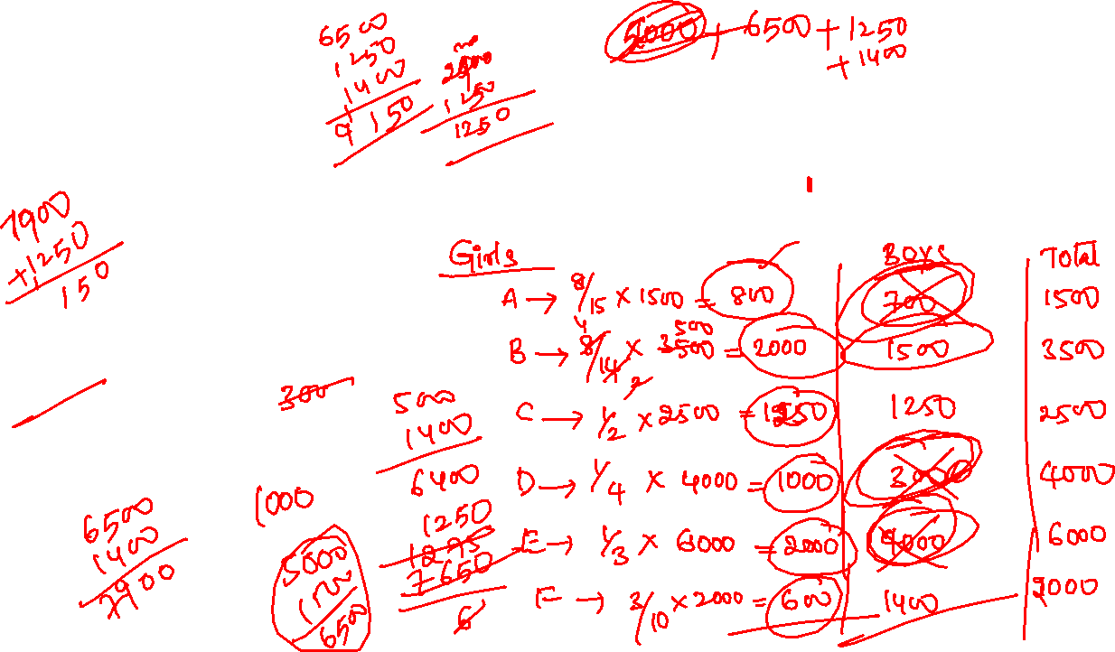
01
1. What is the average of girls in all school?
A. 1375
B. 1275
C. 1225
D. 1350
E. None of these

Slide 4

01
Q.2 What is the difference between the boys in school F and the girls in school D?
A. 600
B. 700
C. 400
D. 200
E. None of these

Slide 5
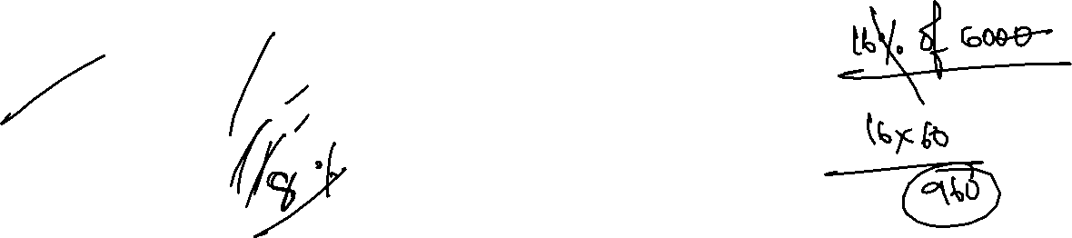
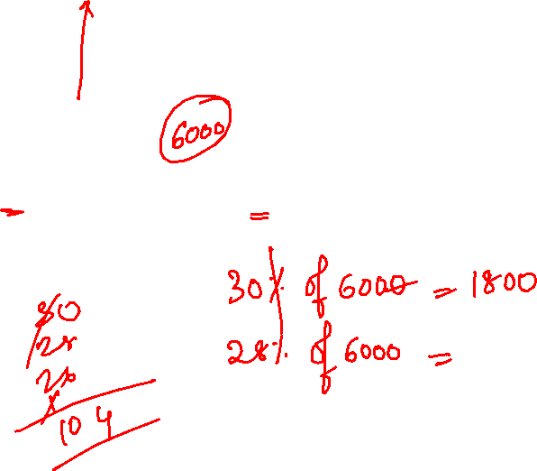
01
Q.3 If in school E 30% students got first division, 28% students got second division, 26% students got third division and rest did not pass. Find the failed students.
A. 1000
B. 900
C. 940
D. 960
E. None of these

Slide 6

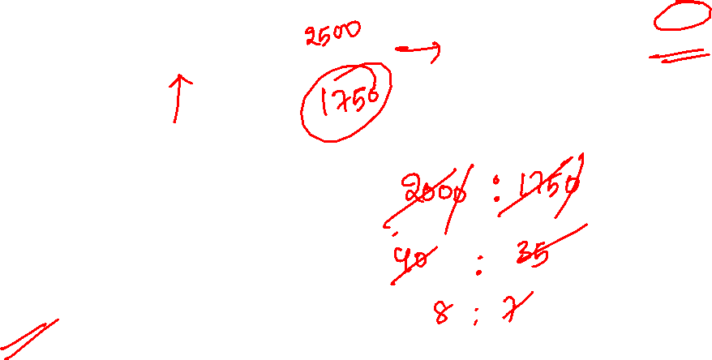
01
Q.4 What is the ratio between girls in school B and boys in school C?
A. 8:5
B. 5:8
C. 6:7
D. 7:6
E. None of these

Slide 7
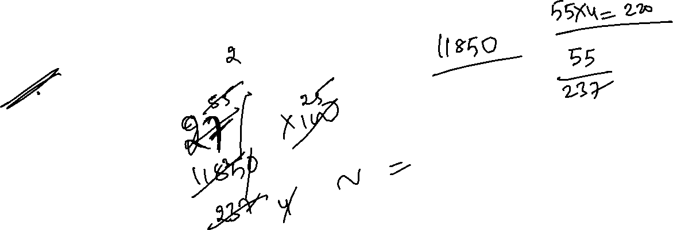
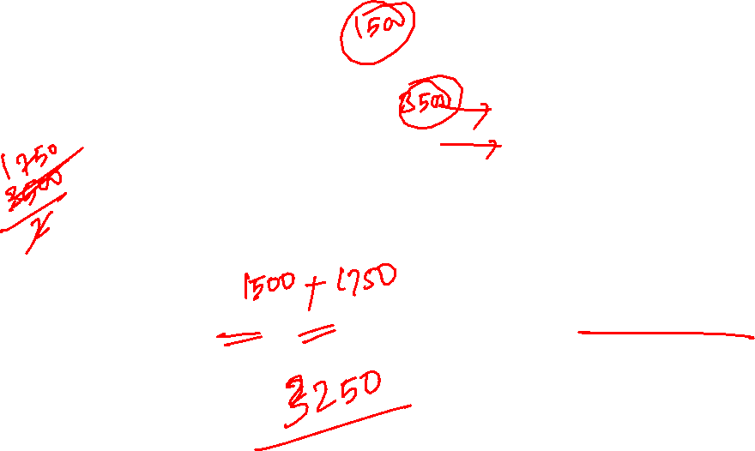
01
Q.5 The boys in school B and C is approximately what % of total no. of boys?
A. 23
B. 28
C. 38
D. 40
E. None of these

Slide 8
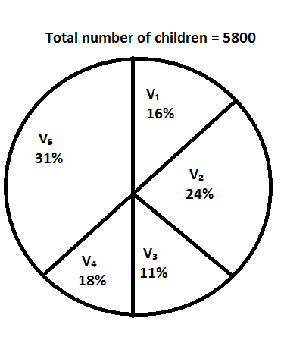
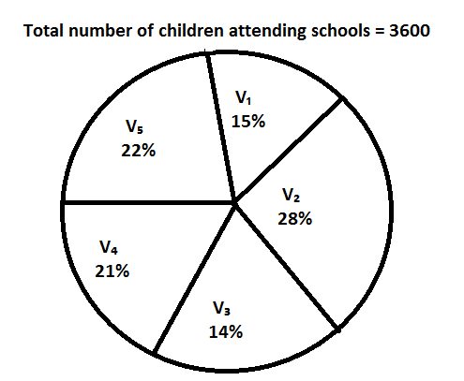
Directions (6-10): Study the following pie - charts carefully and answer the questions given below:
Percentage break up of the number of children in five different villages and break up of children Attending school from those villages
01

Slide 9
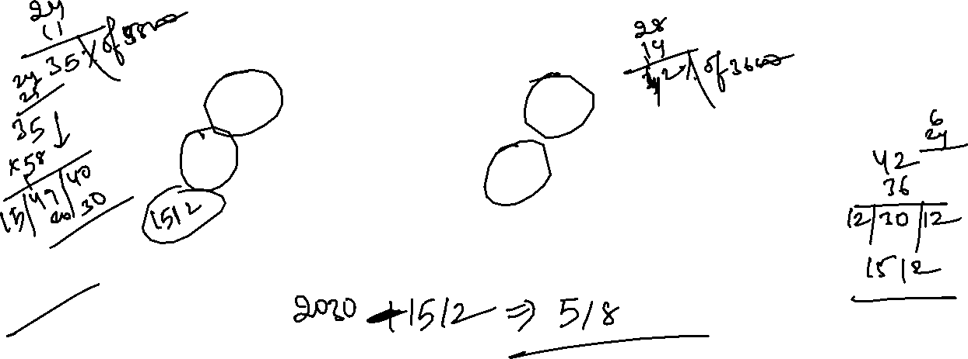
01
6. What is the total number of children not attending school from village V₂ and V₃ together?
1. 528
2. 508
3. 518
4. 618
5. 628

Slide 10
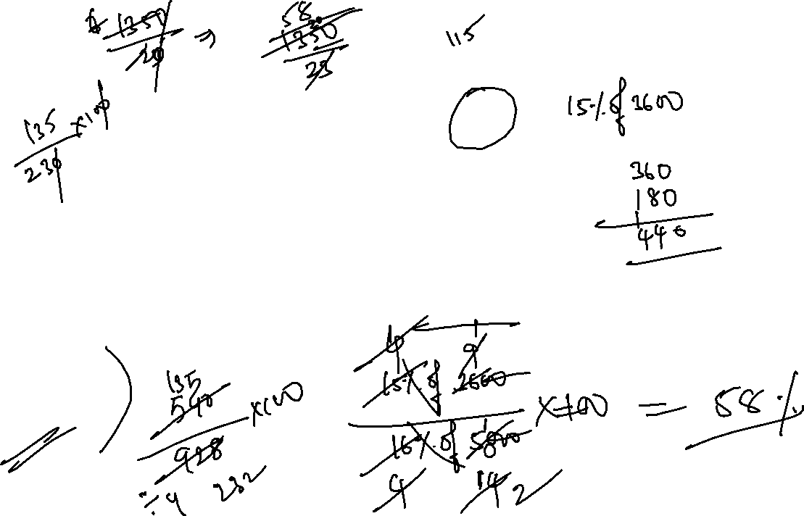
01
7. The number of children attending school from village V₁ is approximate, what percent of the number of children from that village?
54%
56%
60%
53%
58%

Slide 11
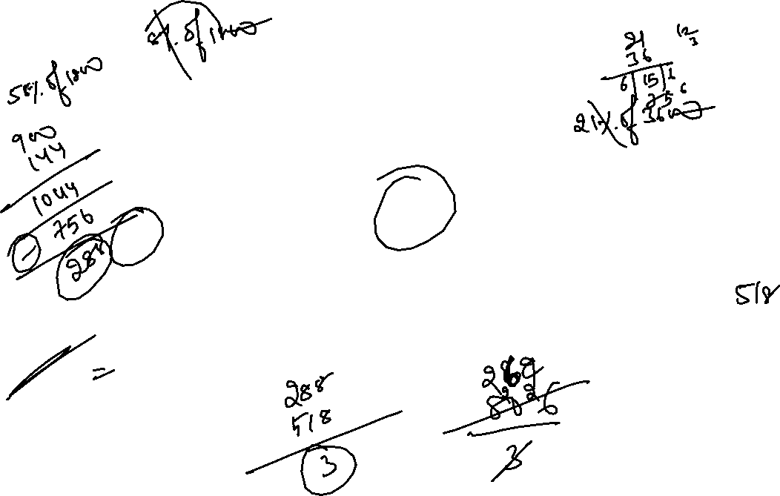
01
8. What is the approximate average number of children not attending school from village V₂, V₃ and V₄ together?
269
258
264
270
266

Slide 12
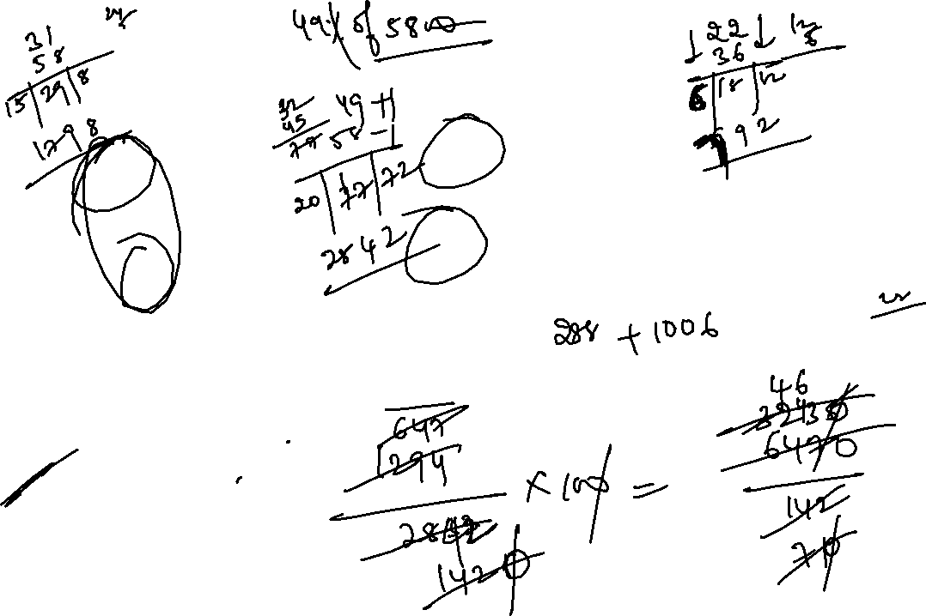
01
9. The number of children not attending school from village V₄ and V₅ is approximately what percent of the total number of children from village V₄ and V₅ together?
43.65%
42.5%
48%
46%
49.45%

Slide 13
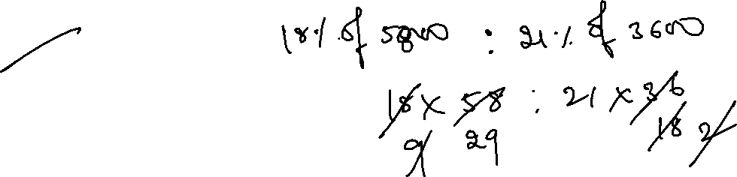
01
10. What is the ratio of the total number of children from village V₄ to the number to children attending school from the same village?
22:21
29:28
29:21
29:27
23:21

Slide 14
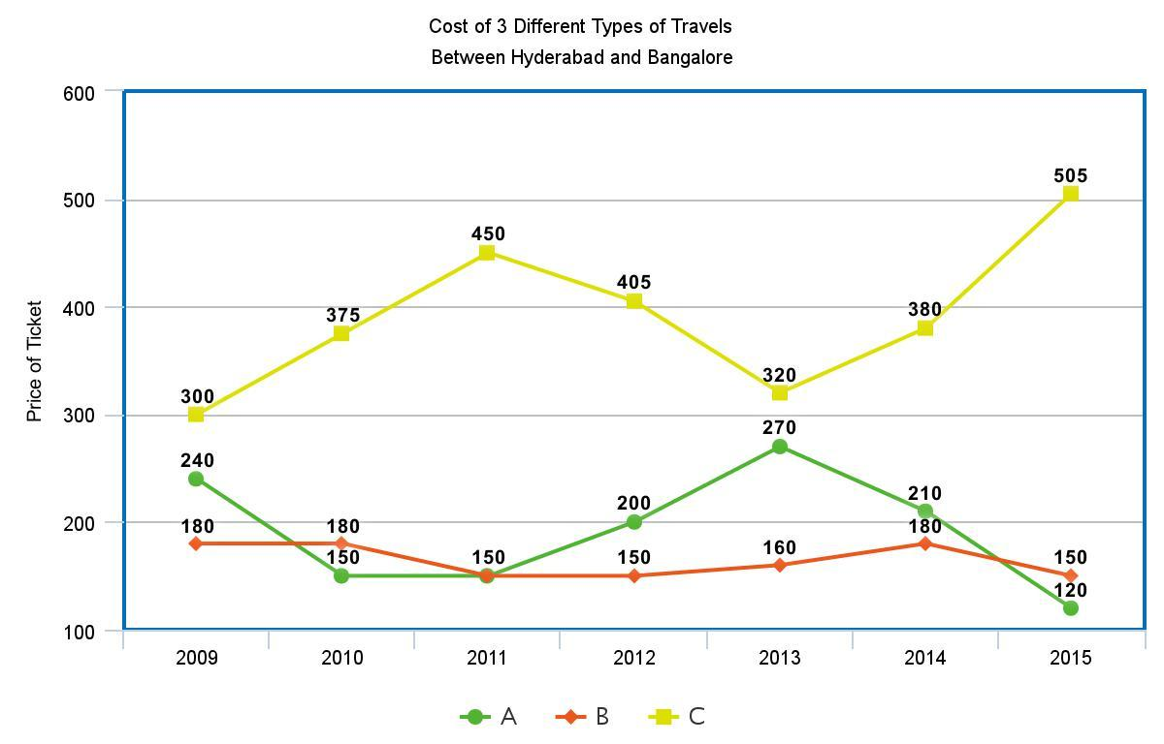
Directions (11-15): Study the following line graph carefully and answer the questions given below:
01

Slide 15
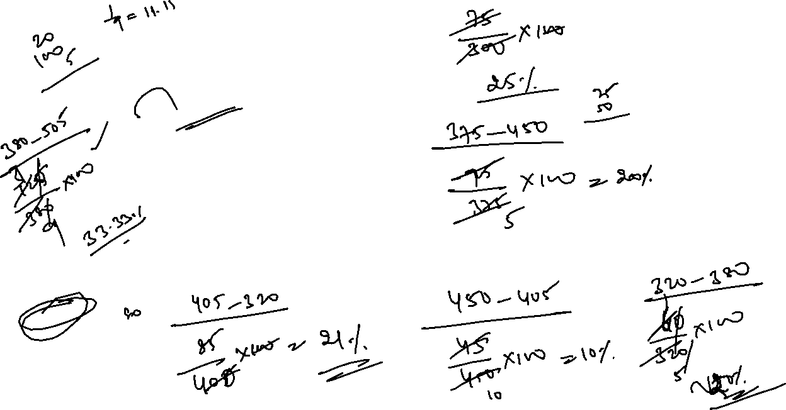
01
11. In which of the following years the percentage increase/decrease in the cost of Travel C with respect to the previous year is the maximum?
2012
2015
2010
2011
None of these
11.

Slide 16
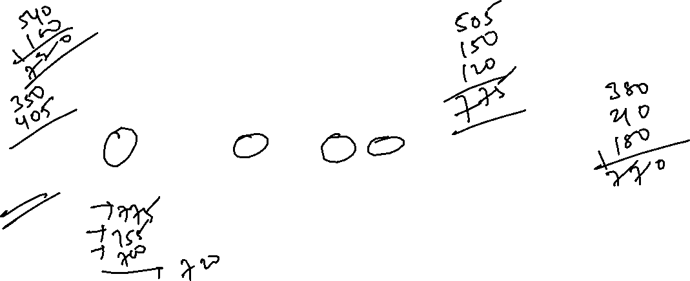
01
12. In which of the following years the cost of all the three travels together is the maximum?
2015
2012
2014
2009
None of these
11.
12.

Slide 17
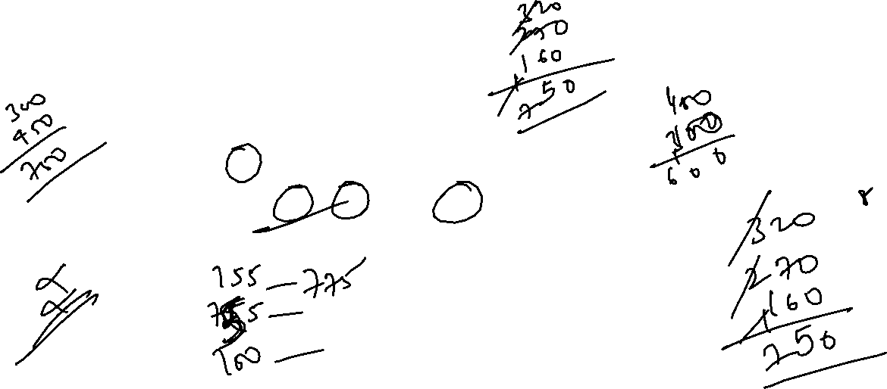
01
13. In which of the following two years the total cost of all three travels is the same?
A. 2012 and 2015
B. 2012 and 2013
C. 2011 and 2013
D. 2010 and 2011
E. None of these
11.
12.

Slide 18
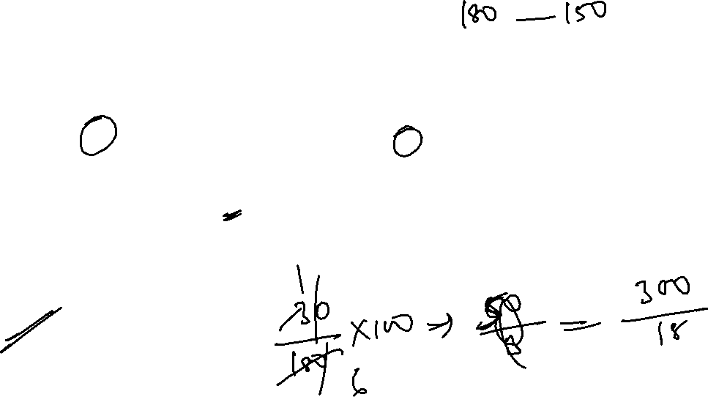
01
14. Find the percentage decrease in the cost of travel B from 2009 to 2015.
20%
15%
24%
16 %
None of these
11.
12.

Slide 19
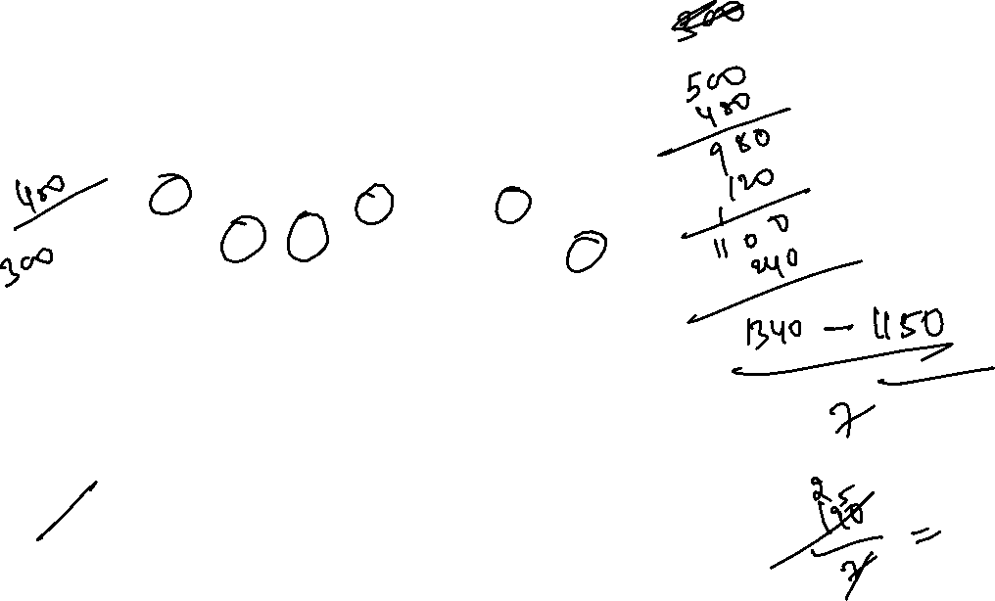
01
15. Find the approximate difference between the average cost of travel A and that of travel B.
Rs. 23
Rs. 30
Rs. 33
Rs. 20
Rs. 27
11.
12.

Slide 20

01
11.
12.

